Slide 1
Honeypot Data Analysis
Wei-Chen Kao

Slide 2
agenda
Data Introduction
Column Descriptions
Data Exploratory
Data Analysis
By different views
Timestamp analysis
Dashboard
Next Step
Initial takeaways
Cloud
Further investigation
Reference
Q&A

Slide 3

Data Introduction

Slide 4
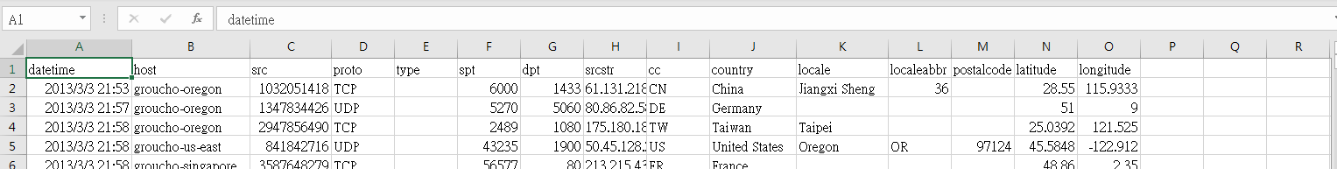
data
datetime: time packets were captured
host: hostname for honeypot
src: source IP (as integer)
srcstr: source IP (as string)
spt: source port
dpt: destination port
proto: network protocol
type: type code field
country: country of source
cc: short country code
locale, localeabbr, postalcode, latitude, longitude: additional geolocale details (based on source IP)

Slide 5
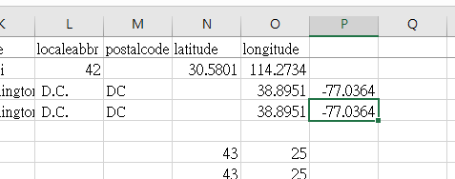
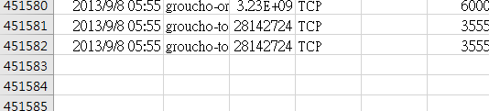
data Exploratory
There are total 451,581 rows in dataset, means that 451,581 times of attack
The date time in this dataset is from ‘2013-03-03 21:53:59’ to ‘2013-09-08 05:55:13’; About 5 months.
There is a mismatch in some columns
There is some missing data that can’t be recovered by the existing data
The data contains geographic location info

Slide 6

Data analysis
distribution & trends

Slide 7
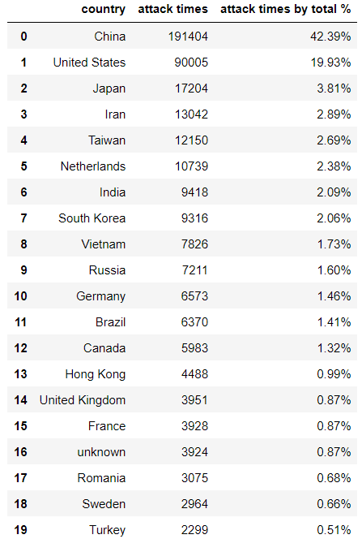
analysis by Country
Top 20 Attacks by Country
Top 5: China, United States, Japan, Iran, Taiwan
Most of the attacks came from China, 42.39% of the total attacks
United States is the second, but attacks are less than half of the attacks from China (19.93%)
Rest of the countries are less than 4%
Attacks from unknown country is 0.87%

Slide 8
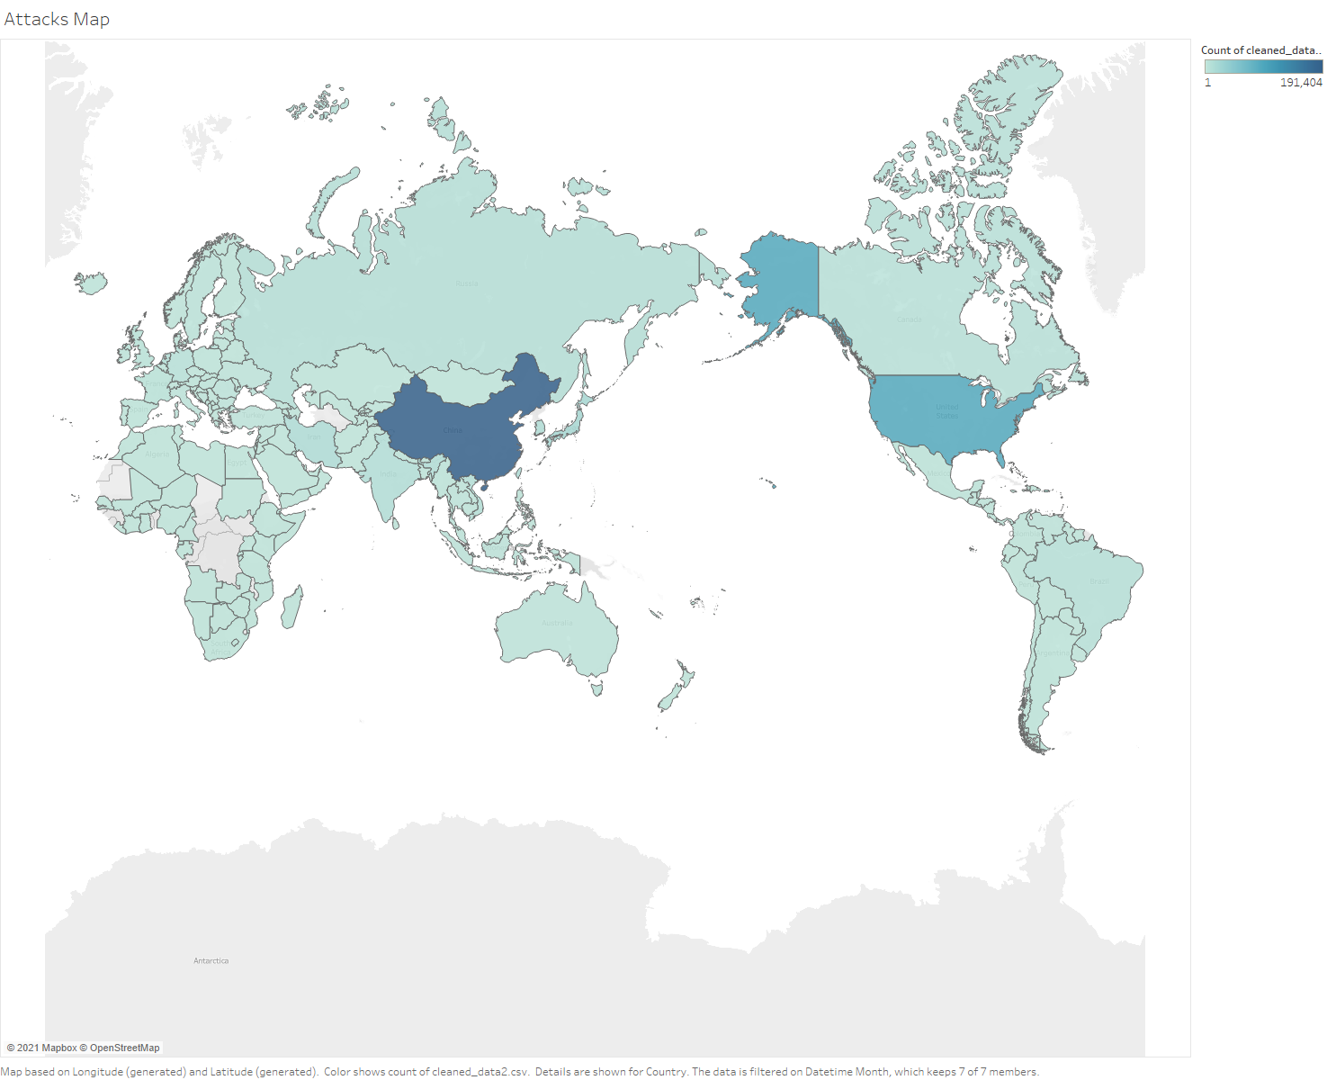
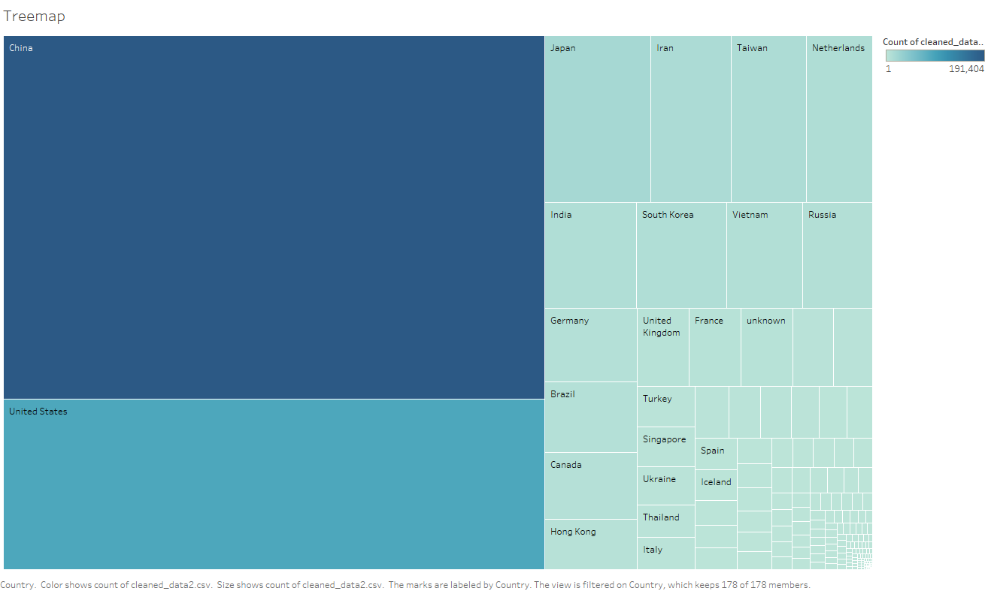

Slide 9
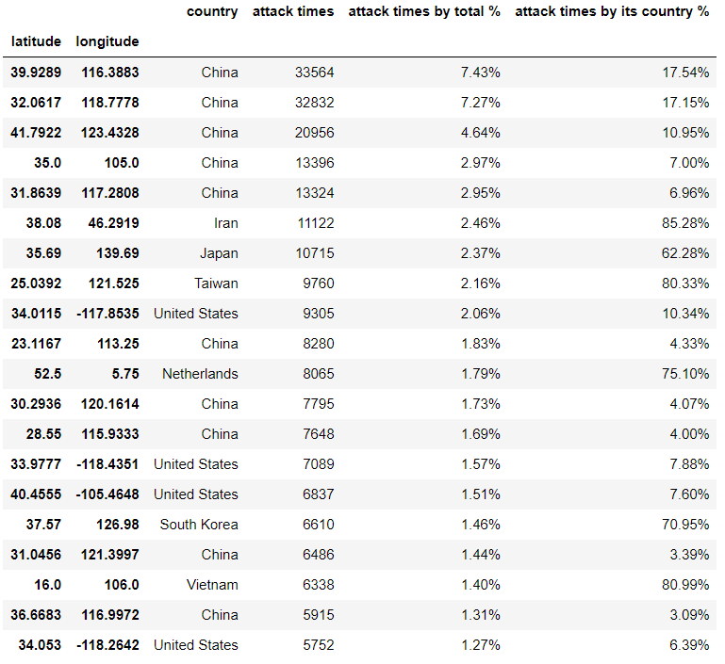
analysis by location
Top 20 Attacks by Location
Attacks from China and US were separated from different location in country
3 of the top 5 countries (Japan, Iran, Taiwan), most of the attacks were from one location

Slide 10
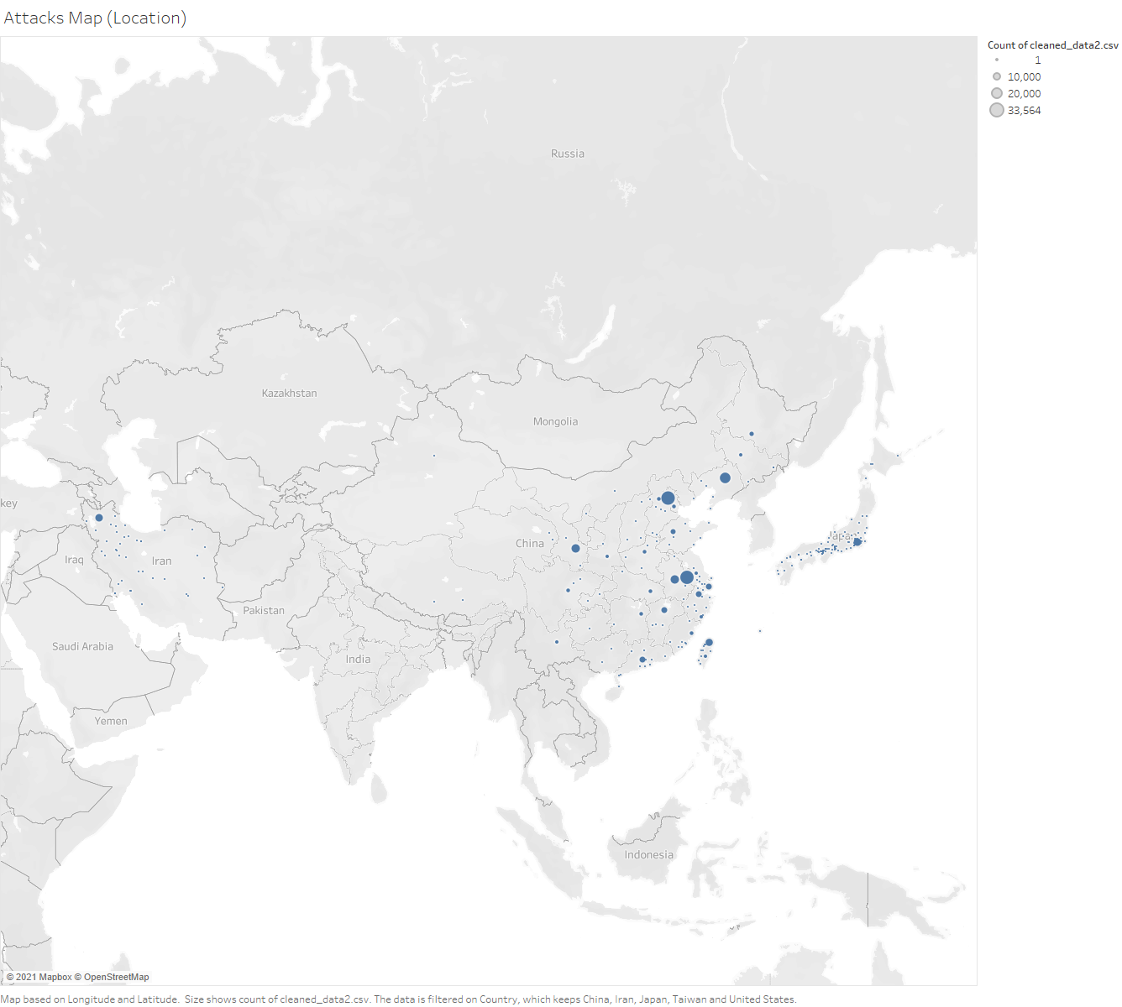
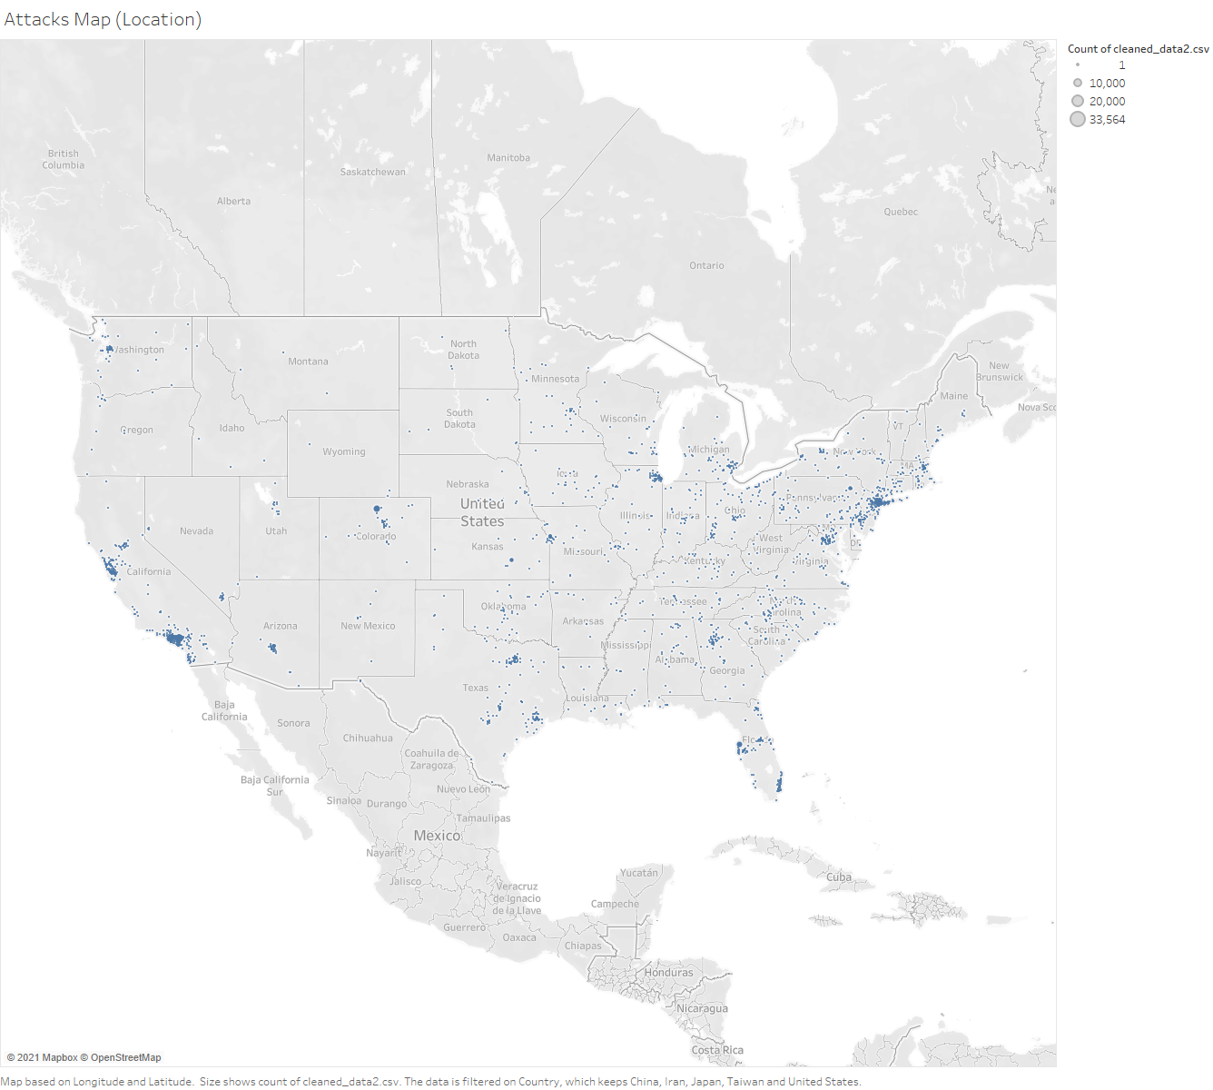
Top 5 Country Location Attack Map

Slide 11
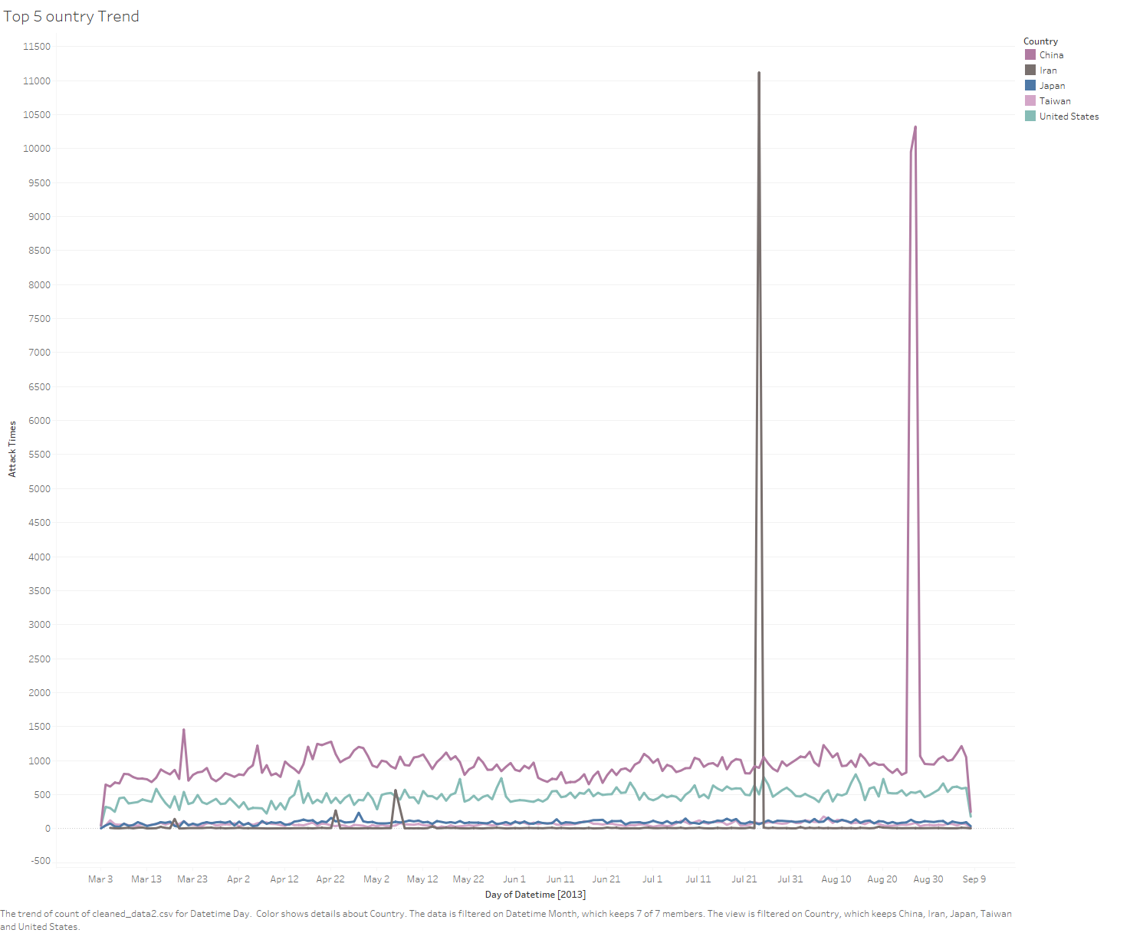
analysis by Date
Most of the attacks from China and Iran were made in one or two days
In September, attacks started to reduce

Slide 12
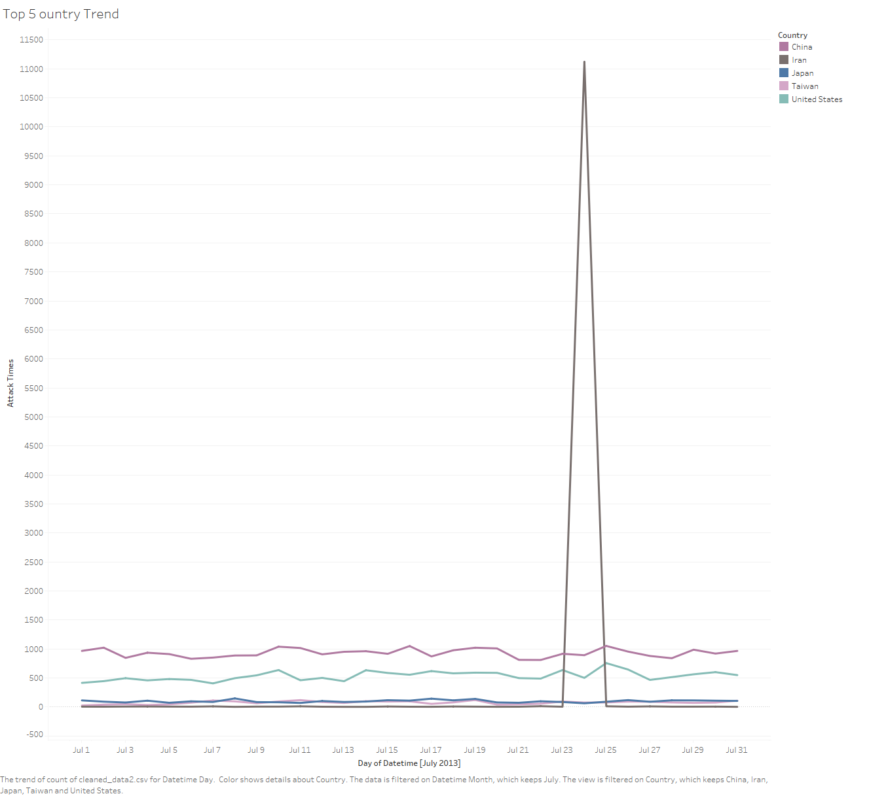
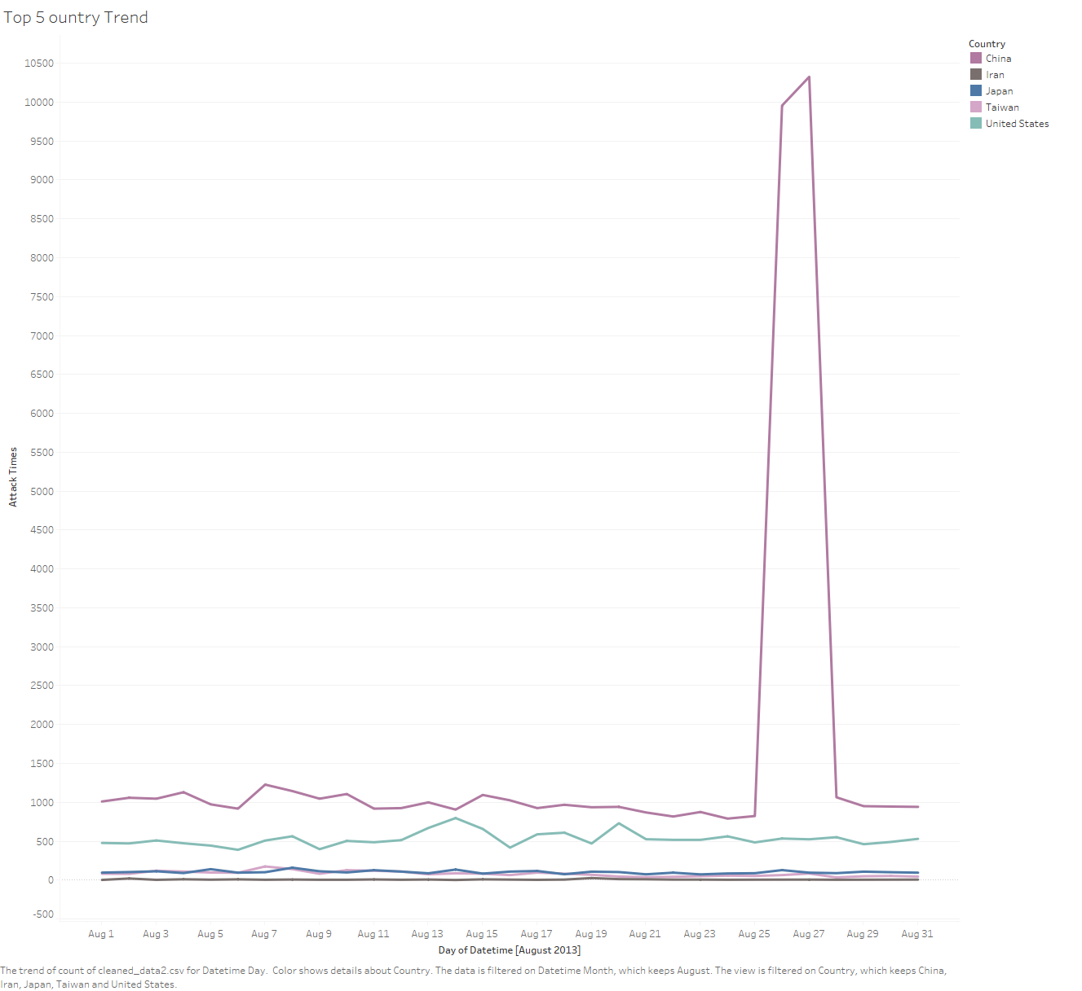
July
August

Slide 13
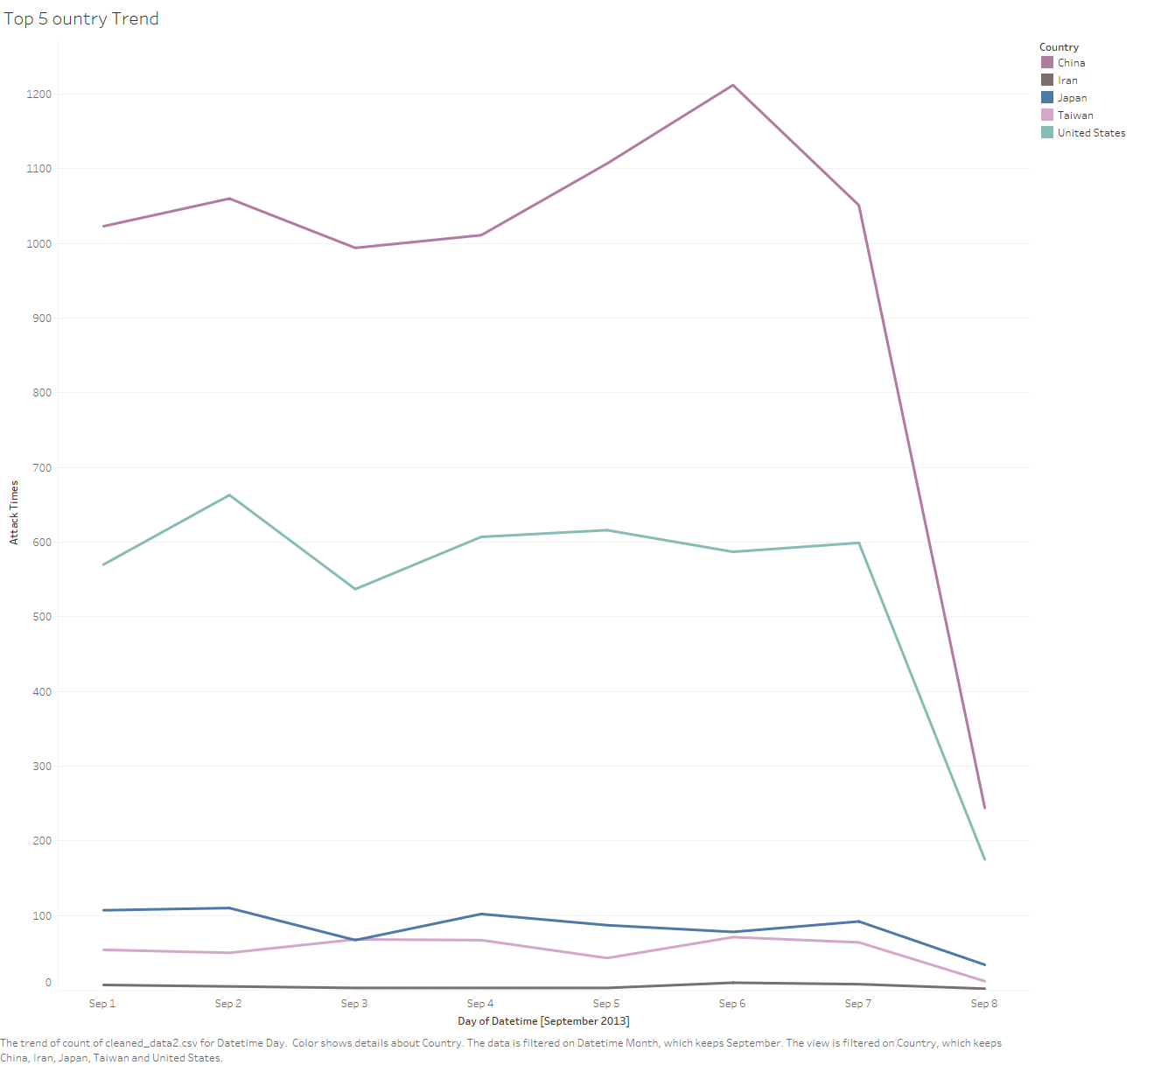
September

Slide 14
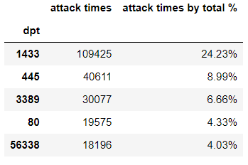
analysis by destination port
Most of the attacks were using port 1433 as the destination port.
Port 1433 is ‘Microsoft SQL Server database management system (MSSQL) server’
https://en.wikipedia.org/wiki/List_of_TCP_and_UDP_port_numbers

Slide 15
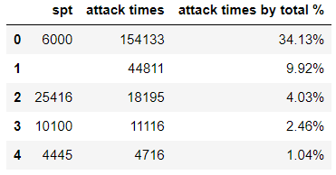
analysis by source port
Most of the attacks were using port 6000 as the source port.
Port 6000 is ‘X11—used between an X client and server over the network’
unknown
https://en.wikipedia.org/wiki/List_of_TCP_and_UDP_port_numbers

Slide 16
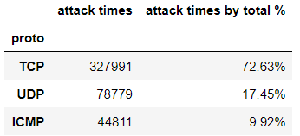
analysis by network protocol
Most of the were using TCP network protocol (Transport Layer)
High reliability
Point to point

Slide 17

Next step

Slide 18
Initial takeaways
China is the country most likely running scans against our networks
There are some countries, most of the attacks were from same location. (It means that they are most likely from same person or group)
There are some countries, most of the attacks happened on one day
The attack target is database system
Most of the hackers used TCP network protocol

Slide 19
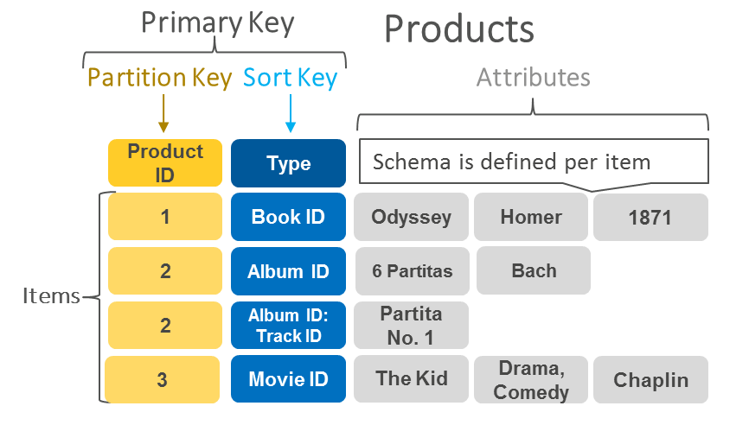
Cloud – real time application AWS DynamoDB
Key value database
NoSQL database – not a relational database
Serverless database
Low latency
Integrated with IAM security
Use this to work on real time application
https://aws.amazon.com/nosql/key-value/?nc1=h_ls

Slide 20
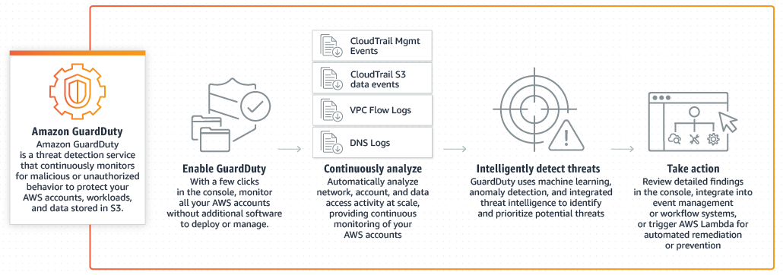
Cloud – security AWS guardduty
Intelligent threat discovery to protect AWS account
Live dashboard
Using the machine learning algorithms
https://aws.amazon.com/guardduty/?nc1=h_ls

Slide 21
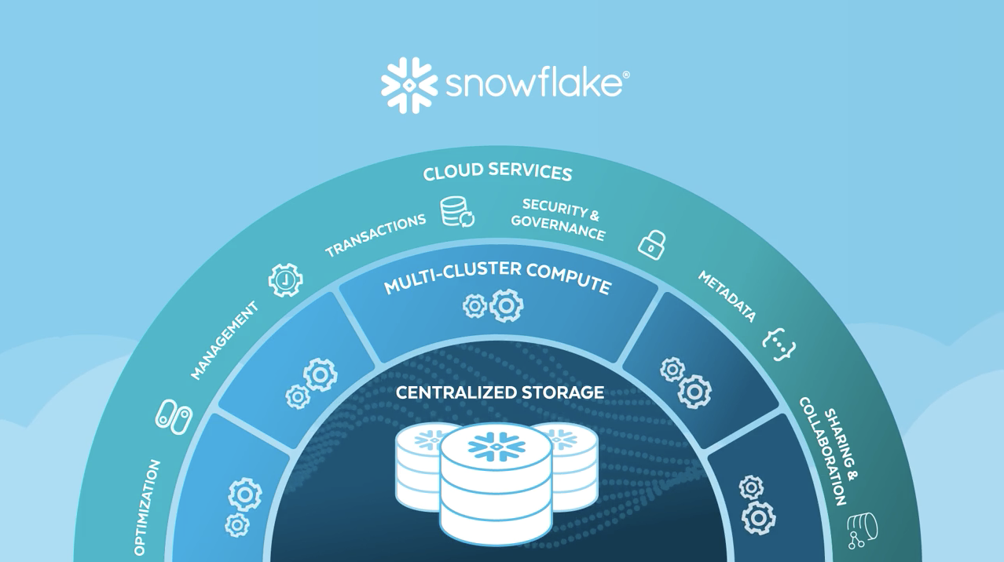
Cloud – Snowflake
A cloud-based data warehouse
Performance – fast, low cost
Concurrency – dashboard, more feature
Simplicity - advantage of cloud

Slide 22
Further investigation - machine learning
Predict the future
Needs to collect more data
Vertically: need more time to collect more data
Horizontally: need more variety of data
Build our own algorithm

Slide 23

reference

Slide 24
reference
https://en.wikipedia.org/wiki/List_of_TCP_and_UDP_port_numbers
https://aws.amazon.com/nosql/key-value/?nc1=h_ls
https://aws.amazon.com/guardduty/?nc1=h_ls
https://www.stitchdata.com/resources/snowflake-vs-redshift/

Slide 25

Q & A

